Slide 1




Peoples Empowerment Group
ISBM COLLEGE OF ENGINEERING, NANDE, PUNE
A
Project Presentation
On
IOT Scribe System for Visually Impaired Students
Team Members:- 1.Sanket Sherki
2.Om Rajesh Mallepelli
3.Vaishnav Waghre
4.Chaitanya Somuse

Slide 2
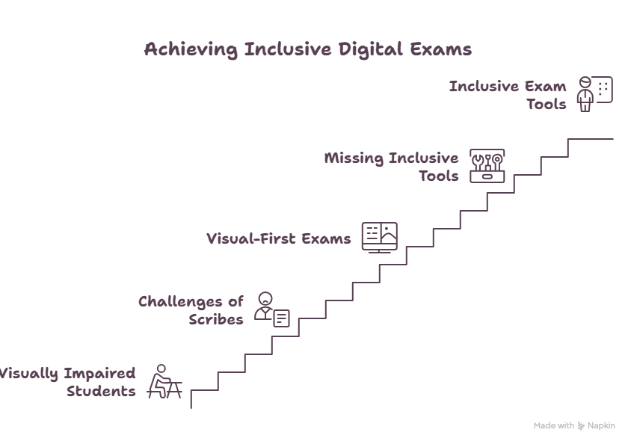
PROBLEM STATEMENT
The Reality Today:
• Visually impaired students depend on human scribes
• Leads to bias, privacy loss & recurring cost
• Existing digital exams are visual-first
• Inclusive exam tools are missing

Slide 3
PROPOSED SYSTEM
Design an assistive examination device for visually impaired students.
Convert examination questions into audio instructions.
Allow students to select answers using dedicated buttons.
Display the selected answer for invigilator verification.
Store examination responses digitally.
Enable wireless transfer of examination data using IoT.
Develop a low-cost and user-friendly solution.

Slide 4
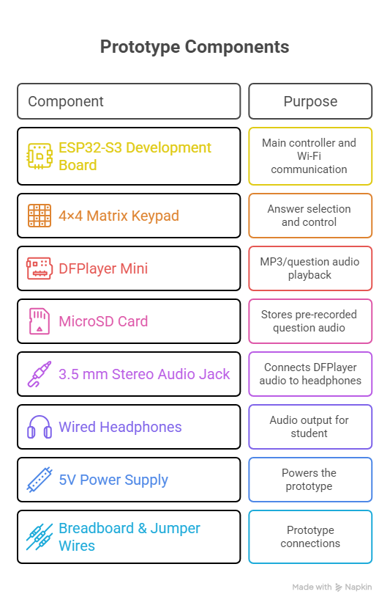
SPECIFICATIONS

Slide 5
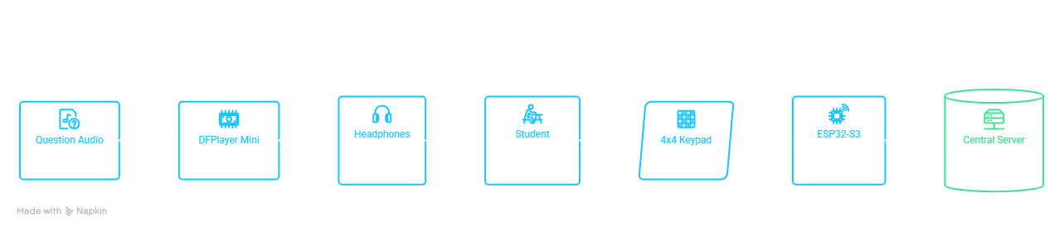
WORKING
Start Exam
↓
Play Question
↓
Student Listens
↓
Select 1 / 2 / 3 / 4
↓
Change / Repeat / Pause
↓
Press #
↓
Save Answer
↓
Send Through Wi-Fi
↓
Next Question
Keypad:
1 → A
2 → B
3 → C
4 → D
0 → Repeat
* → Pause/Resume
# → Confirm

Slide 6
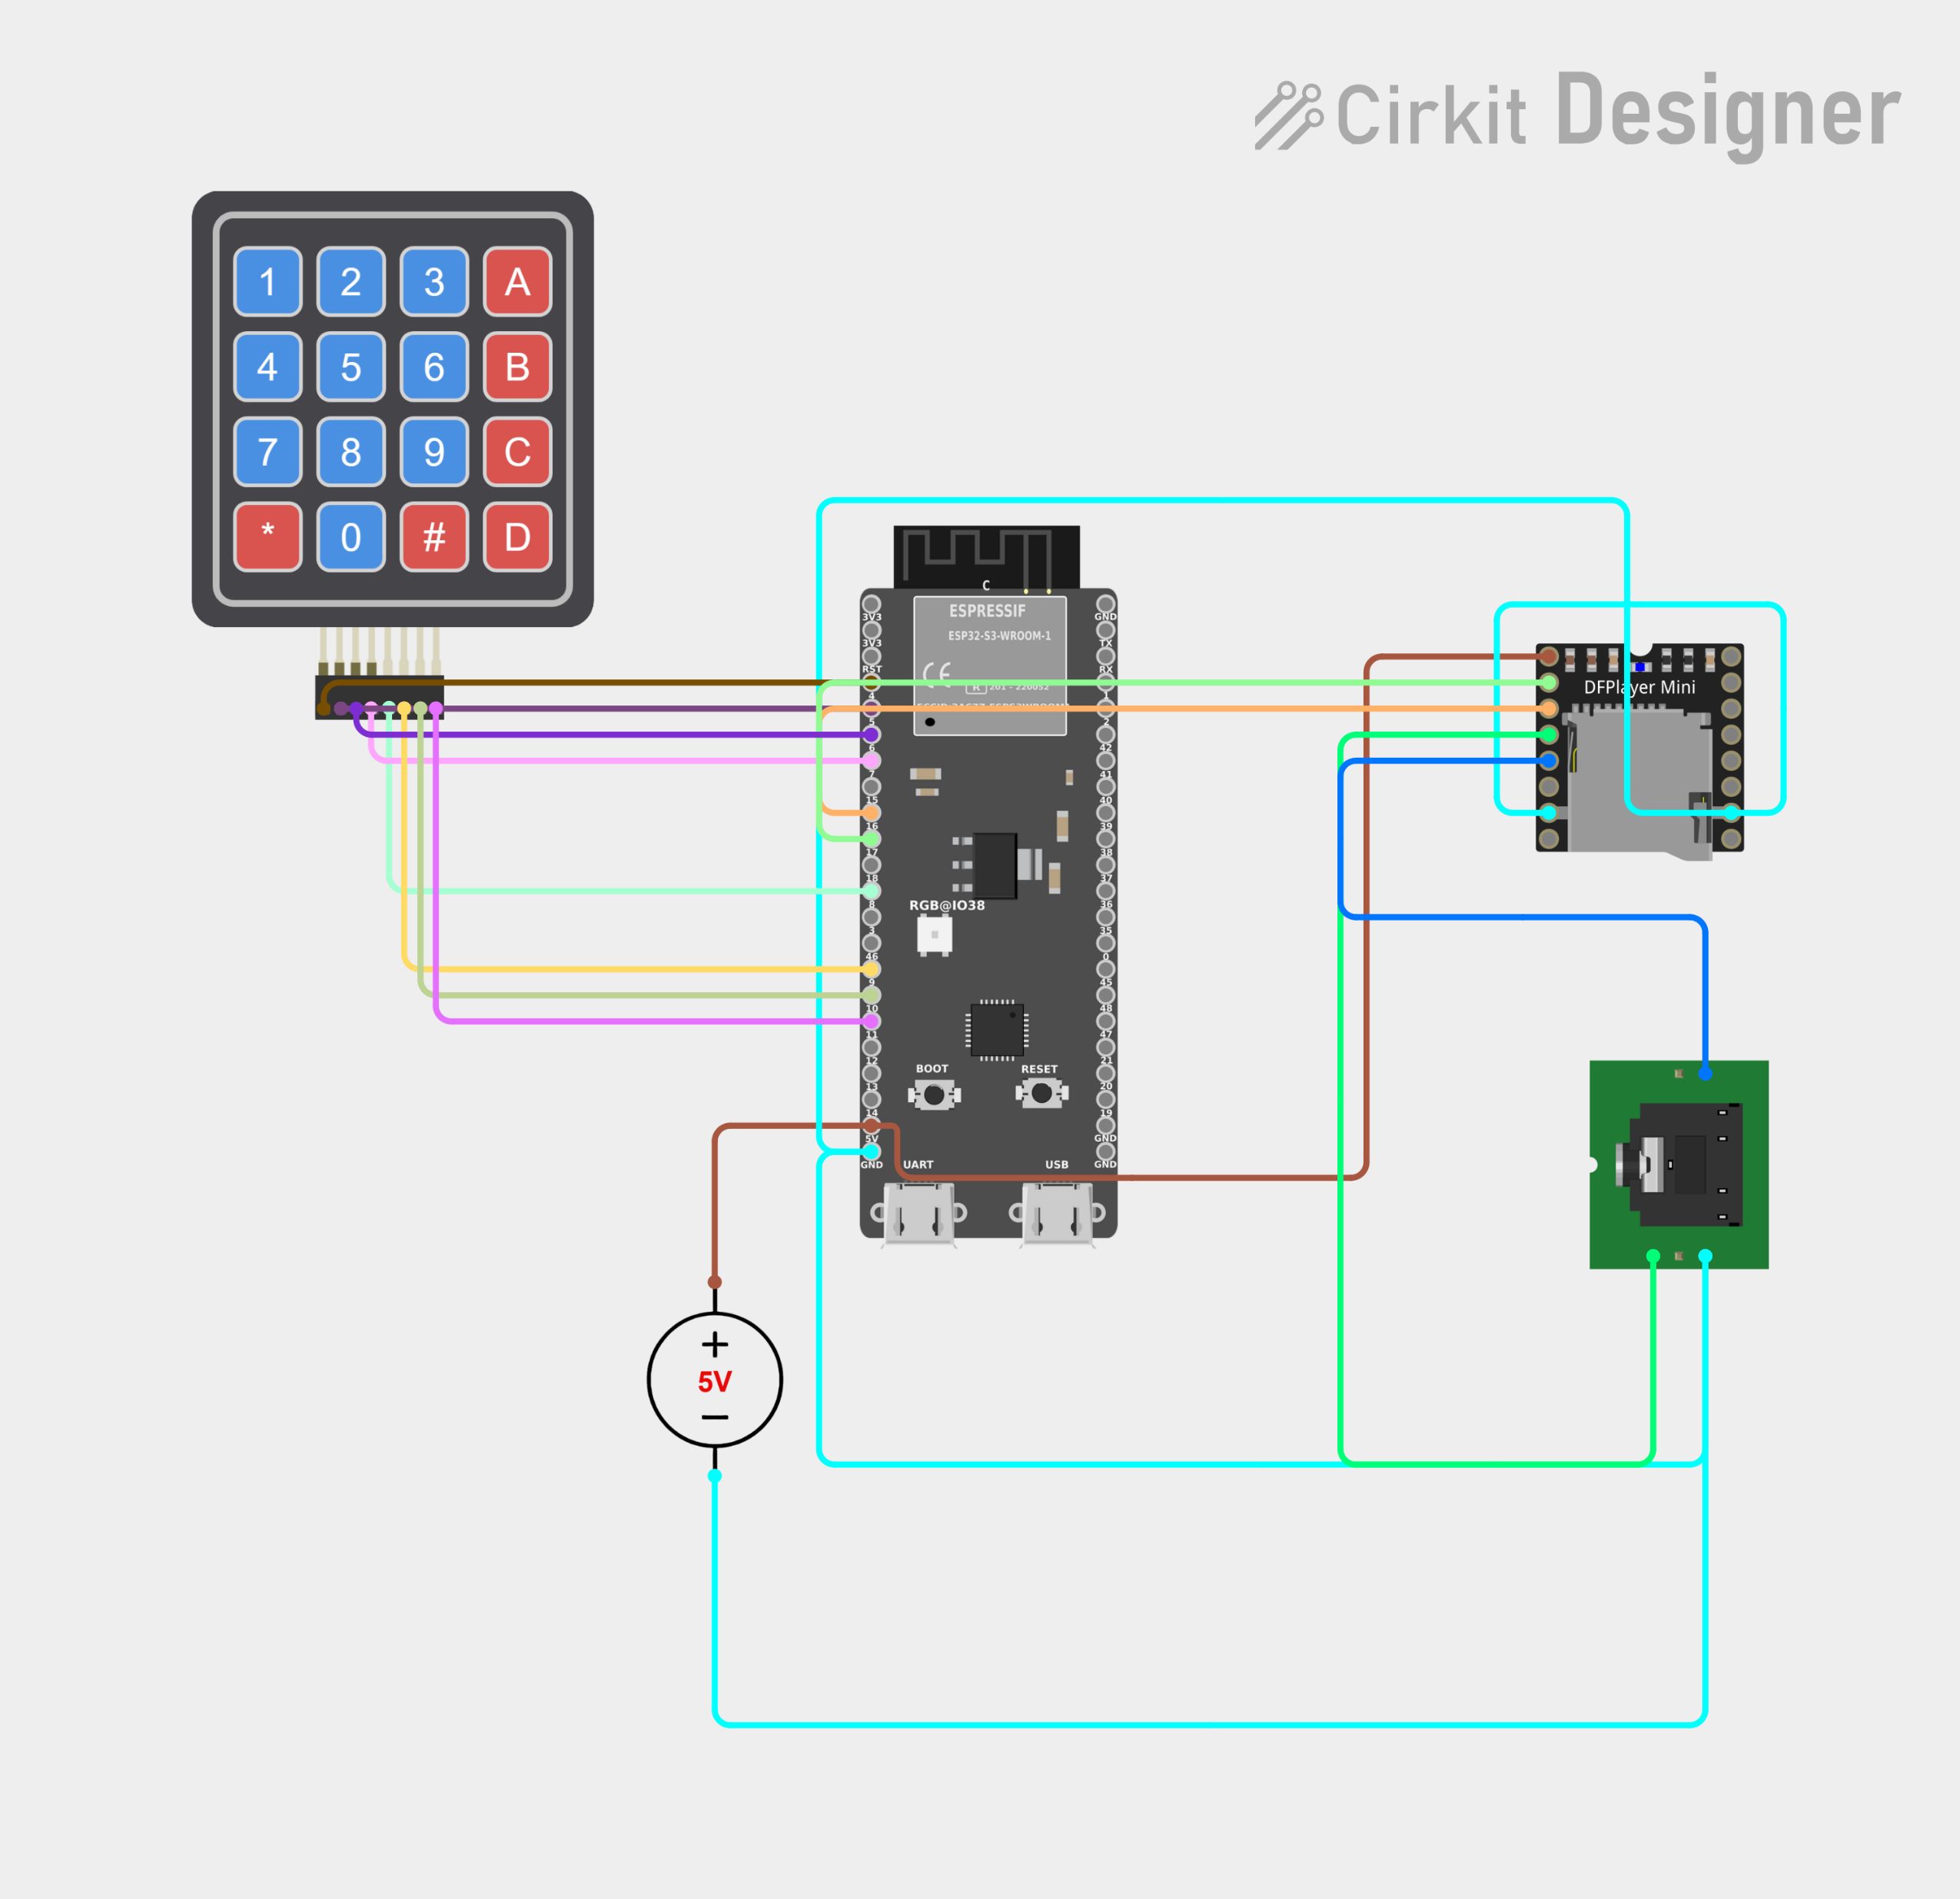
IOT ARCHITECTURE

Slide 7
Progress and Future Work
Current Progress
System architecture finalized
Hardware components identified
Circuit designed in Cirkit Designer
Keypad functionality defined
DFPlayer audio workflow defined
Next Steps
Assemble hardware
Test audio playback
Program ESP32-S3
Implement answer storage
Implement Wi-Fi communication
Develop dashboard
Test complete prototype

Slide 8
Research Paper Study
Paper 1 (2025)
Title: Assistive Technologies for the Visually Impaired: A Review
Authors: Farzad Cheraghpour Samavati, Ali Rahimi Ghasem Abadi
Journal: Cureus Journal of Computer Science (2025)
DOI: 10.7759/s44389-025-06891-1
Objective
Reviews AI-powered assistive technologies for visually impaired users.
Focuses on speech interfaces, multimodal interaction, wearable devices, and accessibility.
Key Findings
Audio and multimodal interfaces improve accessibility.
Low-cost, offline assistive devices are needed.
User-friendly interfaces increase technology adoption.
AI, IoT, speech processing, and multimodal feedback are emerging trends.
Relation to Our Project
Supports the IoT Scribe System for Visually Impaired Students by recommending audio guidance, affordable ESP32-based hardware, and IoT-enabled assistive technology for independent examination support.
Paper Link
🔗 https://doi.org/10.7759/s44389-025-06891-1
or
🔗 https://www.cureus.com/articles/44389-assistive-technologies-for-the-visually-impaired-a-review

Slide 9
Research Paper Study
Paper 2 (2026)
Title: IoT-powered Wearable Assist Device for Visually Impaired
Authors: Lokesh S., Sukesh P., Tejaswini S., Meera M., Udhayakumar G.
Journal: Disability and Rehabilitation: Assistive Technology (2026)
DOI: 10.1080/17483107.2025.2582033
Objective
Develops an IoT-enabled wearable assistive device for visually impaired users.
Integrates ESP32-CAM, ultrasonic sensors, object detection, and voice feedback to improve mobility and environmental awareness.
Key Findings
IoT-based wearable devices improve mobility and independence.
Real-time object detection and voice feedback enhance accessibility and safety.
ESP32-CAM with ultrasonic sensors provides a low-cost and efficient assistive solution.
Achieved over 90% recognition accuracy with low computational latency.
Relation to Our Project
Supports the proposed IoT Scribe System for Visually Impaired Students by validating the use of ESP32-based IoT hardware, audio guidance, and affordable embedded systems to improve accessibility and independence during examinations.
Paper Link
🔗 https://pubmed.ncbi.nlm.nih.gov/41182323/
or
🔗 https://doi.org/10.1080/17483107.2025.2582033

Slide 10
Thank You

